Slide 1
Homework #4
2017 Fall, GCT522, Computer Graphics Theory and Application
Sunjin Jung
2018.10.22

Slide 2

Homework #4
Blendshape

Slide 3
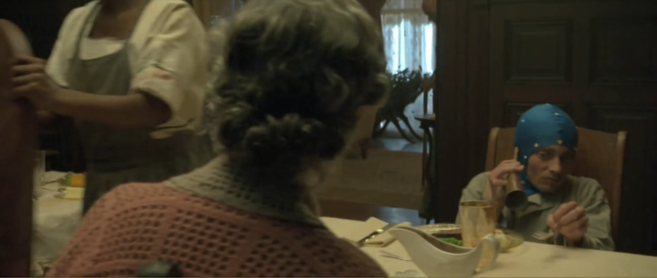
The Curious Case of Benjamin Button

Slide 4
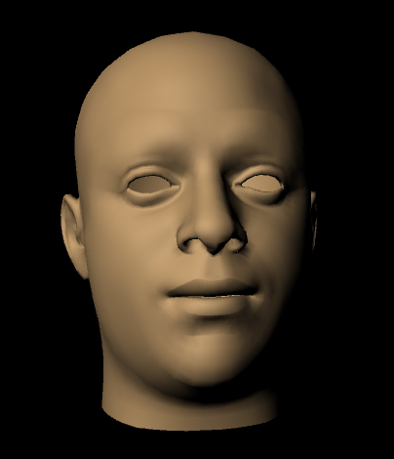
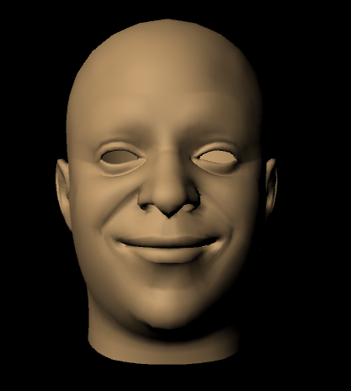
Goal
To make facial expression from the neutral input mesh
Input mesh
target mesh

Slide 5

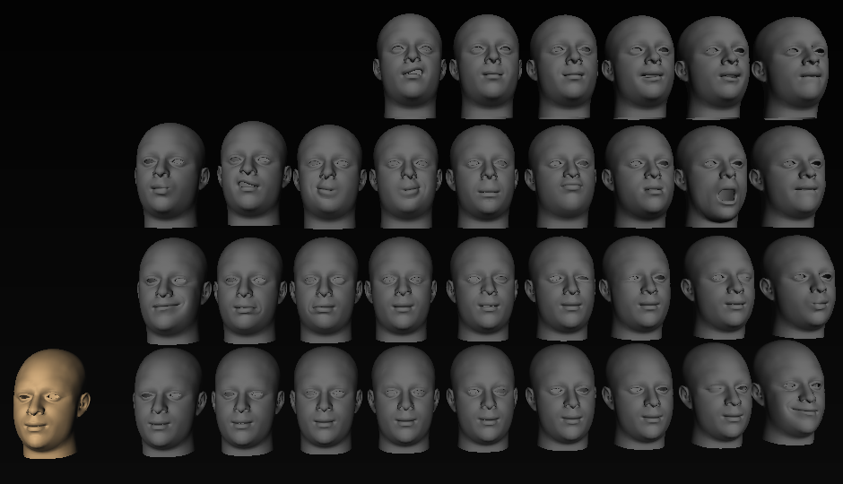
Blendshape
Pre-defined shapes
…
Input mesh
target mesh

Slide 6
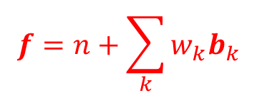
Blendshape
…
$$f=n+\sum_{k}{w_{k}b_{k}}$$

Slide 7
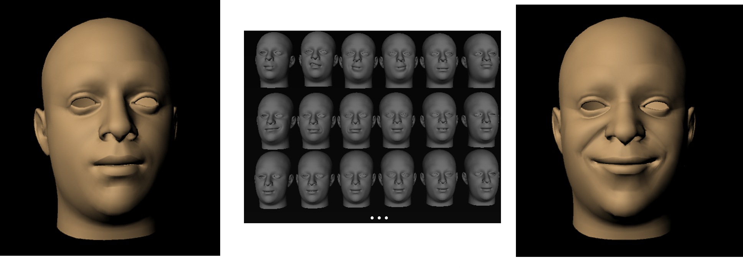



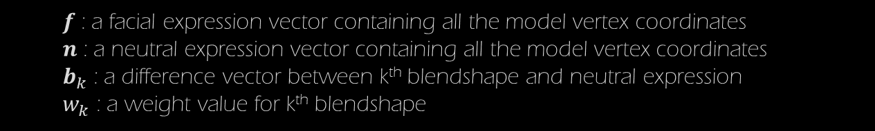
Blendshape
$$n$$
$$f$$
$$f=n+\sum_{k}{w_{k}b_{k}}$$
$f$ : a facial expression vector containing all the model vertex coordinates
$n$ : a neutral expression vector containing all the model vertex coordinates
$b_{k}$ : a difference vector between k^{th} blendshape and neutral expression
$w_{k}$ : a weight value for k^{th} blendshape
New face = neutral face + ∑(deformed face – neutral face) * weight

Slide 8

Homework #4
Blendshape
Get familiar with MAYA Node
Make custom MEL Command and Maya Deformer Node
7 Points
3 Requirements
Due date
5th, November, 14:30

Slide 9
Requirements
1. Make deformer node for a target mesh 4.0 pts
- Make deformer node on a target mesh with your own attributes (2.0 pts)
- Implement main algorithm(blendshape) in deform function (2.0pts)
2. Make command to connect your deformer node 2.0 pts
- Connect attributes using plugs
3. Explain your code & approach 1.0 pts

Slide 10
Demo Scenario
1. Click target mesh
2. Type MEL command “deformer -type yourDeformer”
(don’t make yourDefomer name as “blendShape”, it will generate default maya blendshape deformer)
3. Click created deformer node and source meshes
(or you can choose the node and source meshes by using other options
in your command)
4. Type MEL command “yourCommand”

Slide 11
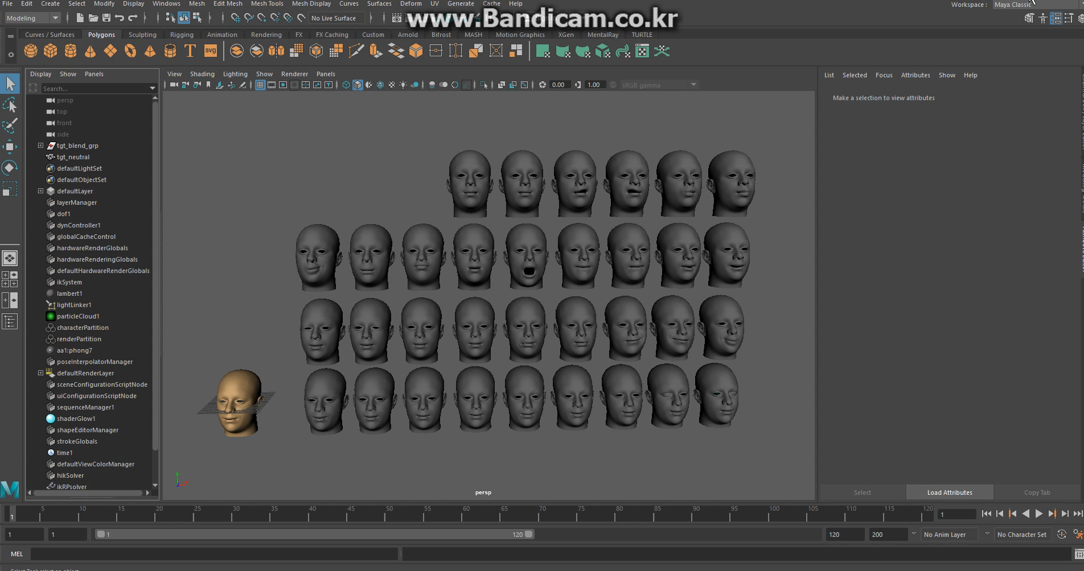
Demo Video

Slide 12
Workflow(Deformer)
1. Create a project using the MPxDeformerNode framework
2. Make attributes using MFnAttribute
- get mesh as input attribute using MFnTypedAttribute (given)
- set weight(0.0~1.0) as input attribute using MFnNumericAttribute
- set your attributes as array to get multiple sources
3. Access to your attributes using MDataHandle
4. Iterate over target mesh(to which deformer node is applied) vertices
- get position of the vertex (target point)
- iterate over the source meshes
delta += (source point – target point) * weight
target point += delta

Slide 13
Workflow(Command)
1. Create Command using the MPxCommand (same as the previous homework #2)
2. Connect the source meshes and weights to your deformer node using MDGModifier
- use MArrayDataBuilder to pre-allocate the size of array attribute
- use MPlug to access the attributes of the node
- iterate the selected source meshes and connect the meshes to the attributes

Slide 14
Tips & Code Snippets
➔ Skeleton Code (KLMS)

Slide 15
References
Maya 2017 API reference
($MAYA_PATH)\devkit\plug-ins\(example)
Complete Maya Programming Book
Chapter 4.5 Nodes
Chapter 4.8 Deformers
Blendshape
Lewis, John P., et al. "Practice and Theory of Blendshape Facial Models." Eurographics (State of the Art Reports) 1.8 (2014).
( ▲ Very important)
You should read these parts before starting your homework!

Slide 16
Submission files
Source code :
.sln / .cpp / . h / .vcproj (Please don’t send me *.sdf)
Complied binary file :
.mll file not dll
Readme.txt file :
Target Machine & software(ex. Maya 2017, x64)
How to use your Command(in detail)
Screen capture file:
Image : 3 different facial expressions (.png file)
Video : demo video in your environment (like a video on page11)

Slide 17
Upload your files to KLMS
until 5th, November, 14:30

Slide 18
Q/A
Sunjin Jung
sunjin225@kaist.ac.kr
#2344, N5 Building / Visual Media Lab. in GSCT

